Slide 1
Biogeochemistry C:N Shoot Grinding Procedure Figures
AMD 11-12-2019

Slide 2
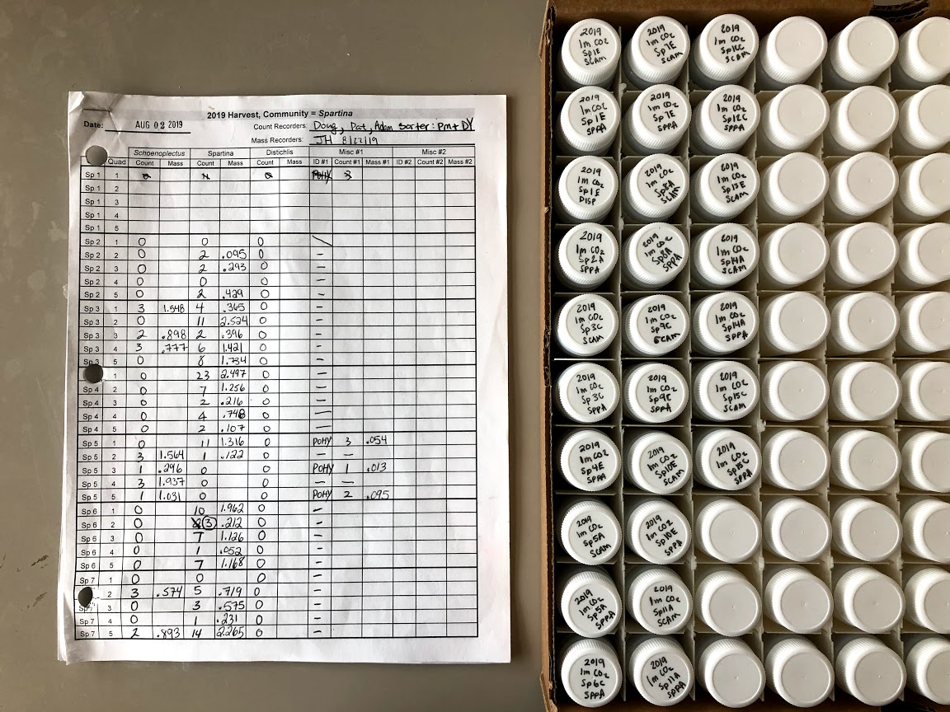
Scintillation Vile Preparation
Label tops of sample tubes* according to which samples are present from the harvest data sheet.
Year 1M CO2 Plot/Ch# Species
2019 1M CO2 SP1E SPPA
*Do not label tubes for Misc. samples

Slide 3
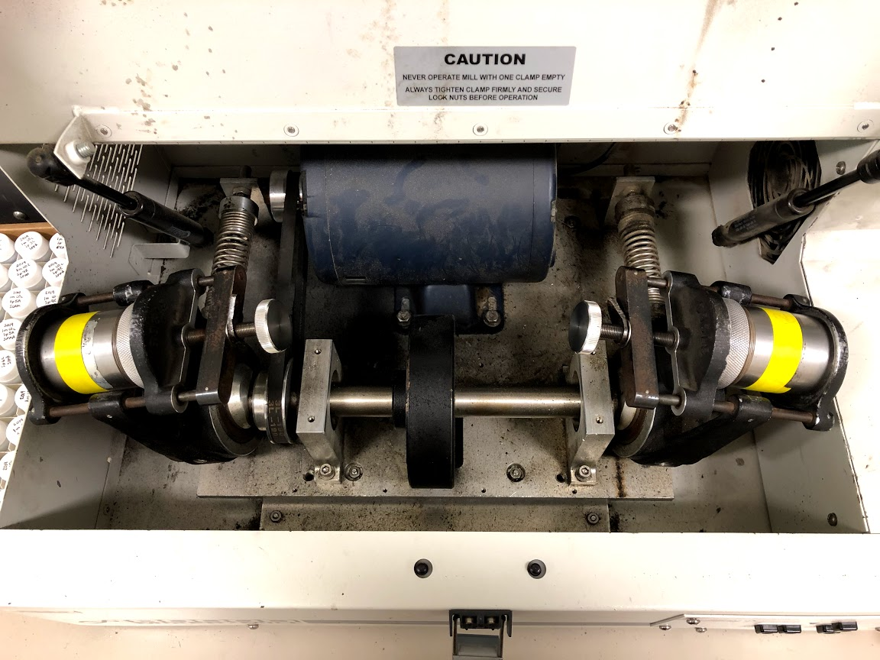
Inspect Mill
- Open the lid of the mill and inspect belt; it should be set on tracks (orange)
- If capsule holsters do not move freely, spray ball-joints with WD-40 and move around (blue)

Slide 4
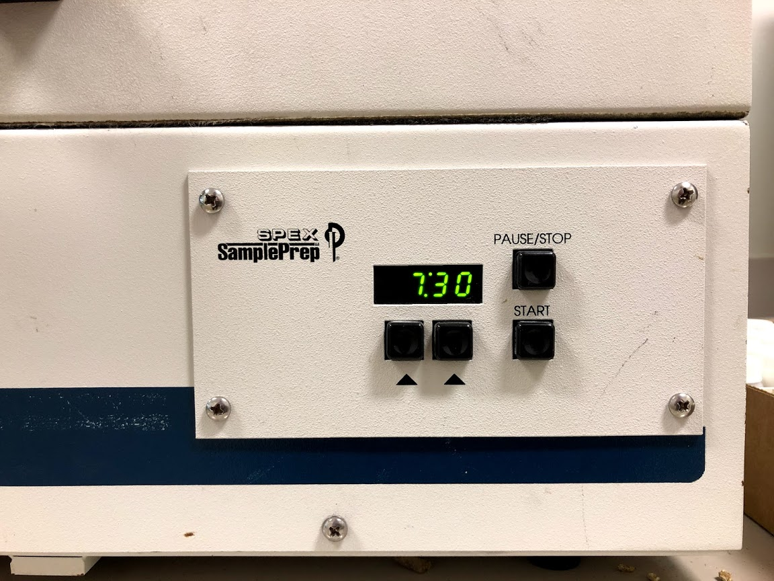
Prep Mill
Turn on mill by flipping the switch by the back-right corner.
Set time to 7min: 30sec by pressing the two buttons below the time display. If you go over the min number it is easier to turn the mill off/on again.

Slide 5
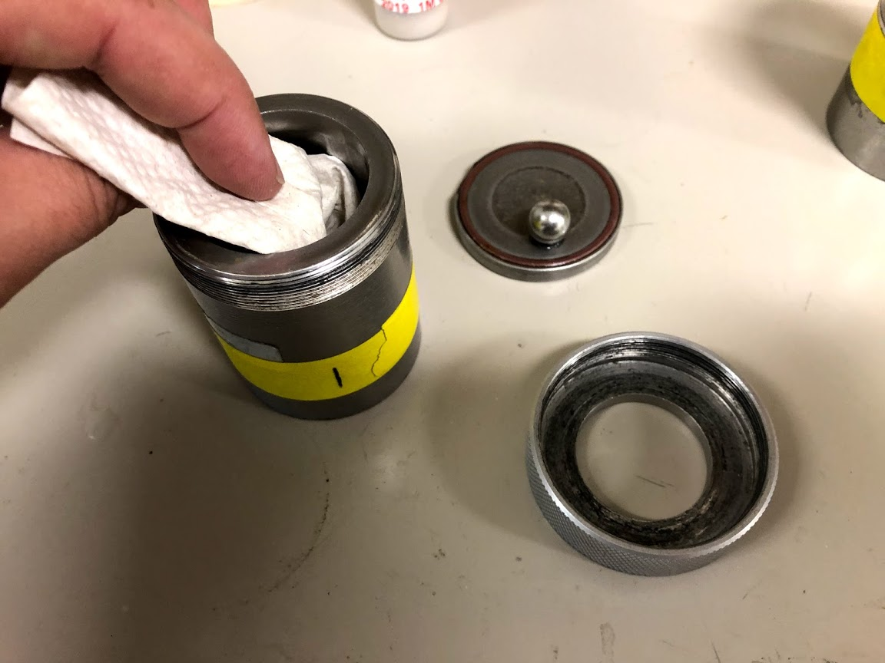
Capsule Sterilization
Use a small amount of ethanol and a towel to sterilize* each capsule.
Make sure to take out the o-ring from the cover and sterilize this region!
*Capsules and components must be completely dry before grinding process begins.

Slide 6
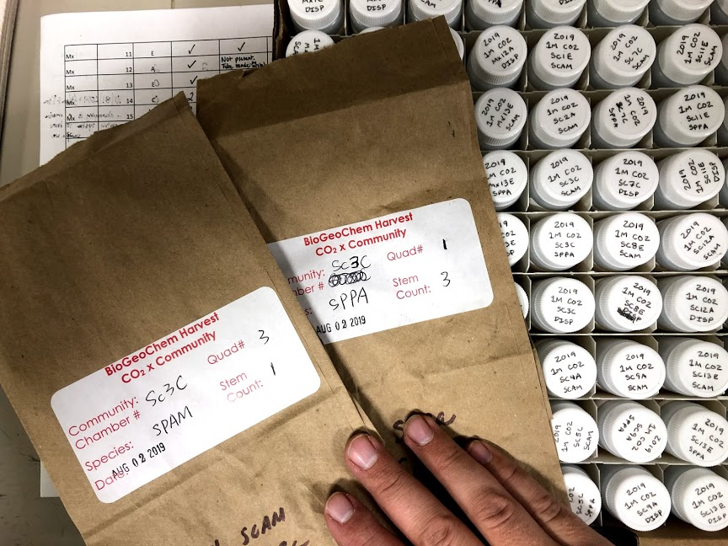
Harvest Bag Organization
Grab harvest bags in sets of 2, and match them with the sample vials that are next.

Slide 7
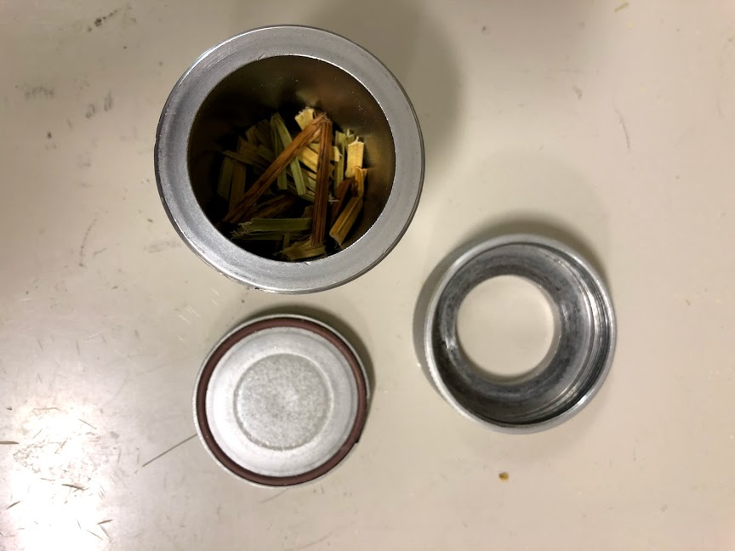
Placing Sample in Capsule
If sample is cut up, gently pour shoot pieces into capsule until it is between ¼ and 1/3.
If sample is not cut up, use a pair of scissors to cut small shoot pieces (≤ 3 cm) in harvest bag, and shake in bag until mixed well.

Slide 8
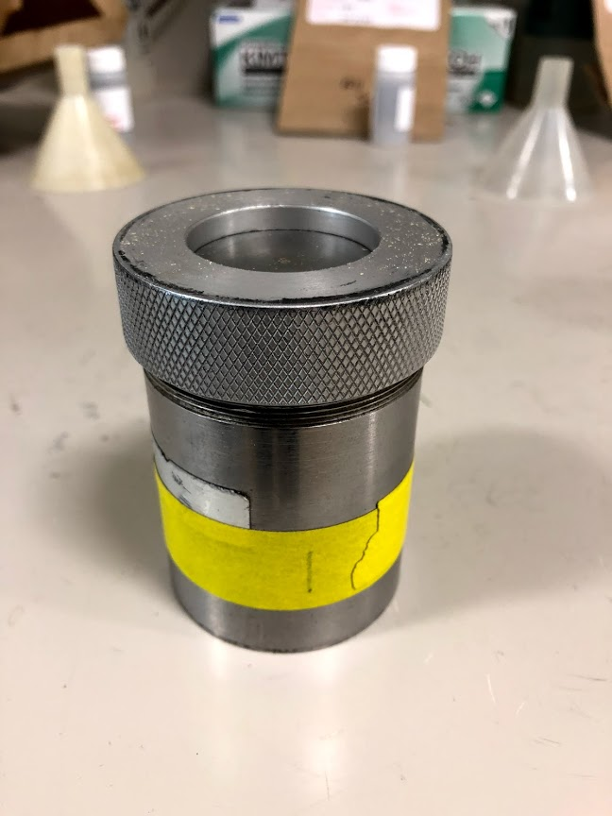
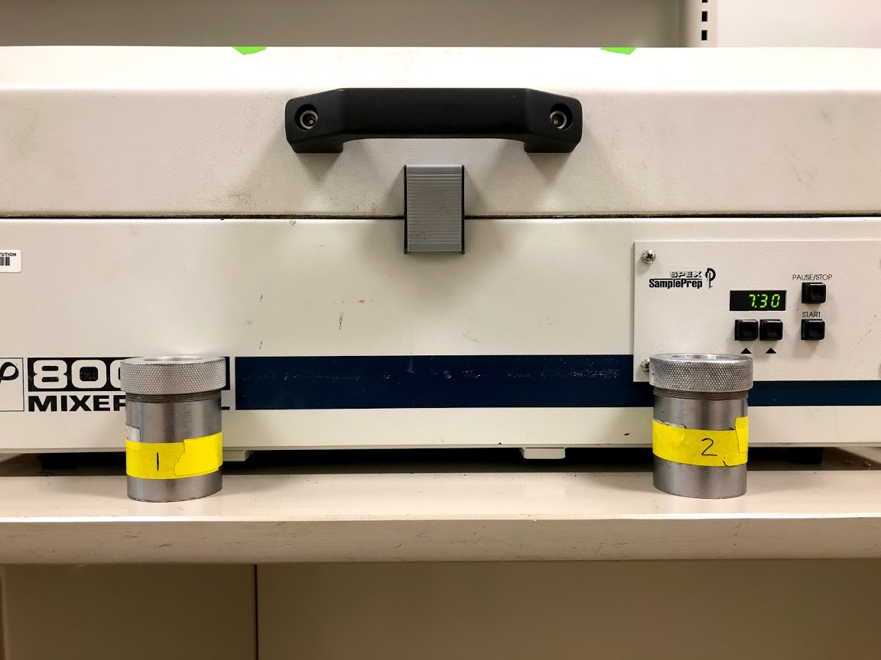
Secure Capsule and Place Next to Mill
Place capsules in front of mill in the correct order (1-2; 3-4). It is important that the order of the samples follows through the whole process.
Place metal ball in capsule, and secure the top tightly.

Slide 9
Place Capsules in Mill
Secure capsules in grinder by tightening the large screws (orange), followed by the locks (blue).

Slide 10
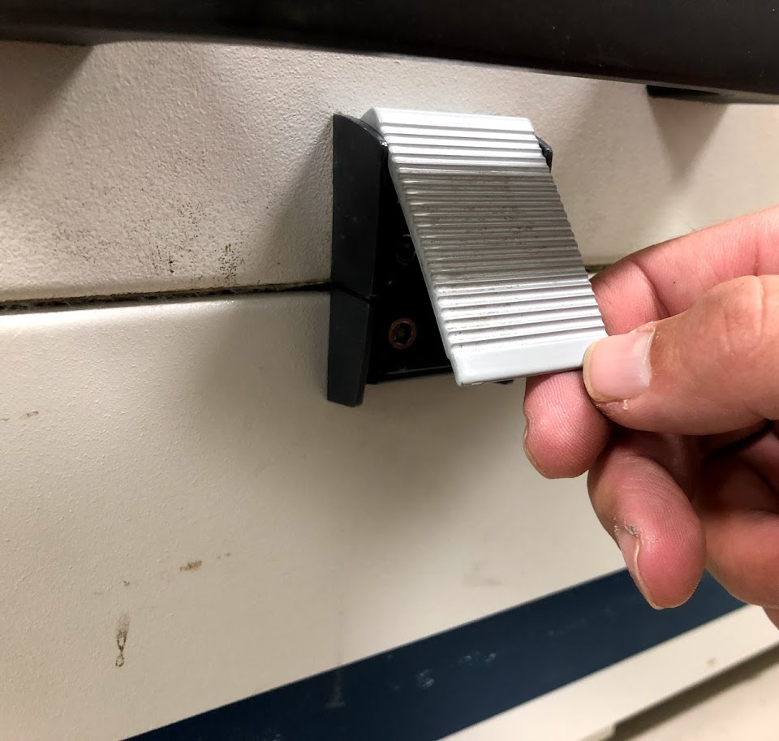
Starting the Mill
Close grinder lid and lock into place.
Press the start button when you are ready.
Listen carefully for sounds that indicate a capsule coming loose. Press the Stop button or flip the on/off switch to stop the machine.

Slide 11
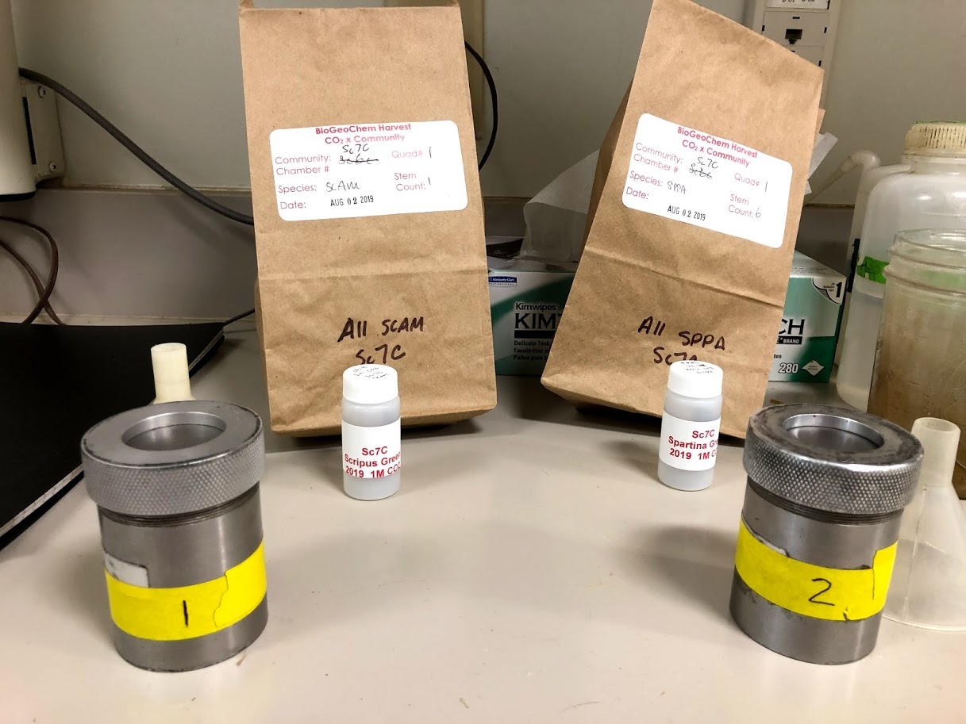
After Mill is Done Running
When the machine has stopped running, place capsules on table in front of correct sample bags.

Slide 12
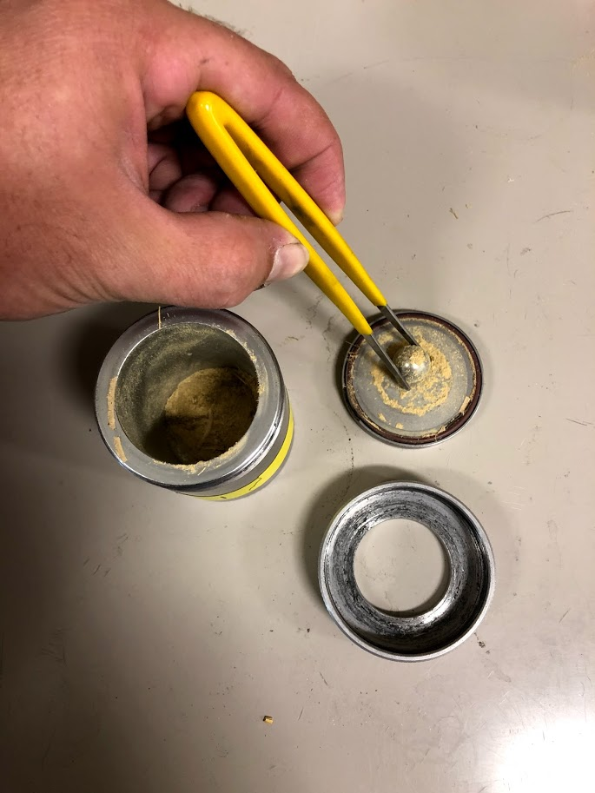
Inspecting Sample
Unscrew top of capsule.
The sample should now b a fine powder with the consistency between flour and sugar.
If sample is the wrong consistency, place back in mill to grind again.
Use tweezers to remove the metal ball from the capsule.

Slide 13
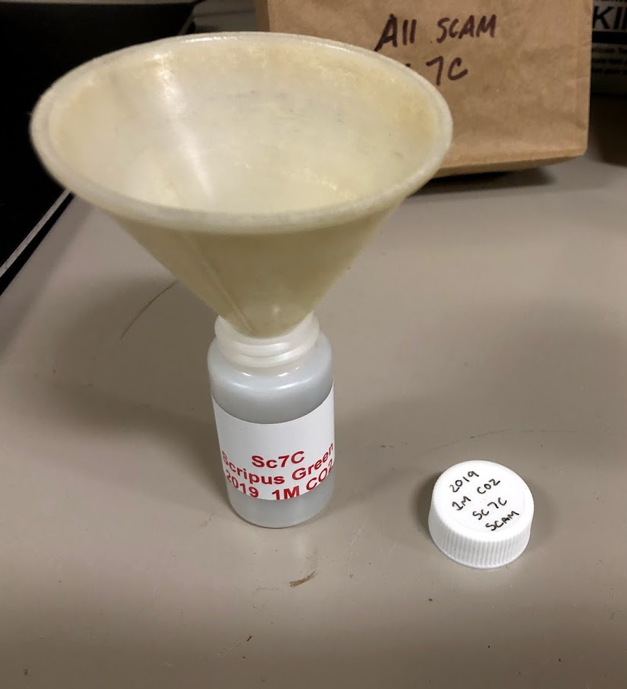
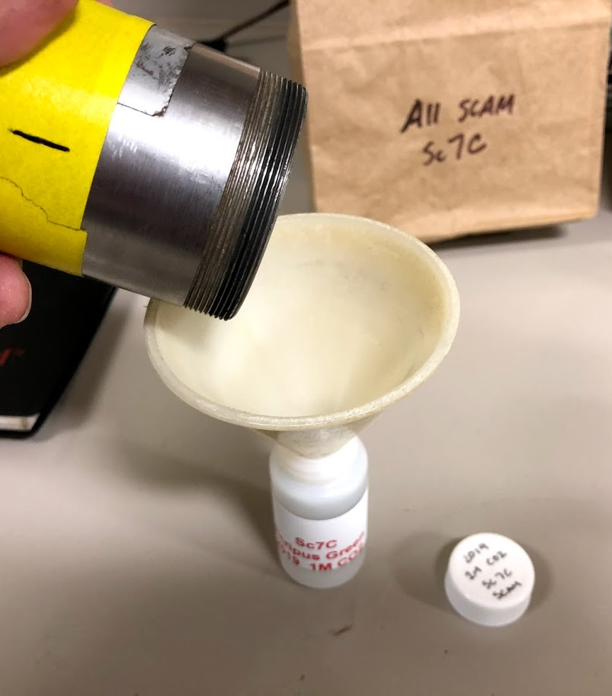
Pouring Sample into Scintillation Vial
Unscrew top of sample vial and place funnel into opening.
Carefully pour powder from capsule into sample vial (w/ two hands).

Slide 14
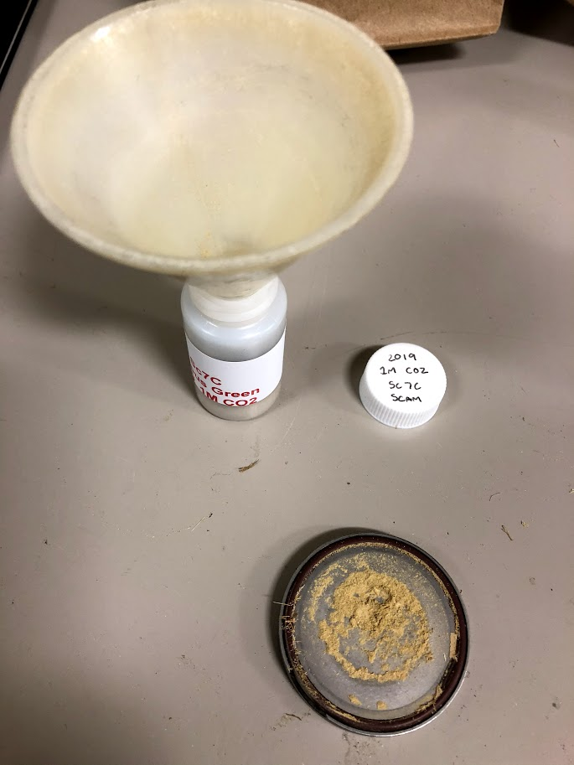
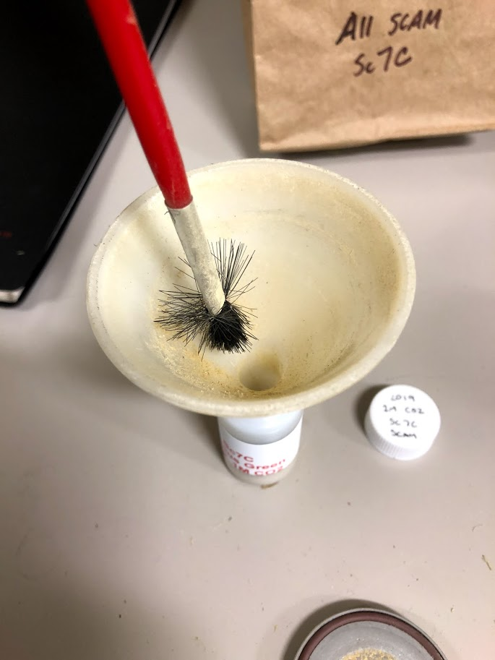
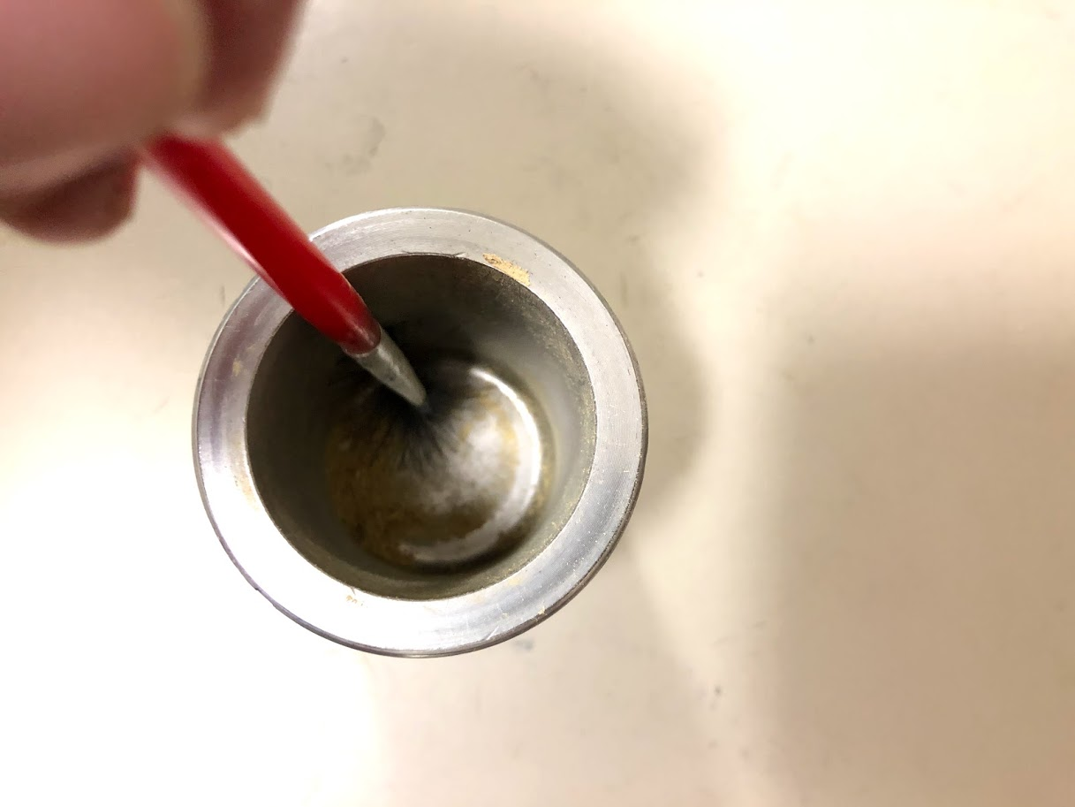
Brush Sample into Scintillation Vial
Use paintbrush to gather particles that did not come out at first.
Use paintbrush to wipe sample on lid into vial.
Use paintbrush to wipe sample from funnel into the vial.

Slide 15
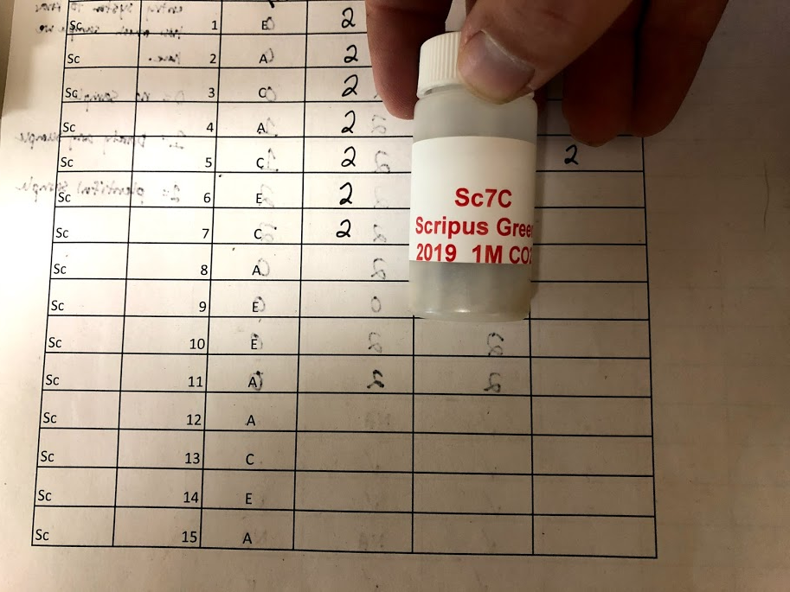
Brush Sample into Scintillation Vial
Securely cap scintillation vial and mark the tracking sheet with the number corresponding to the amount of sample available:
0 = no sample
1 = barely any sample
2 = plentiful sample
Place sample in tray when done.

Slide 16
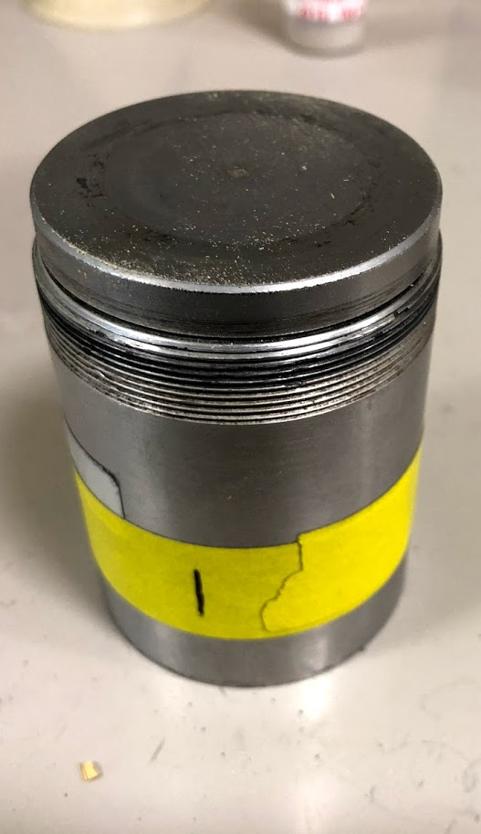
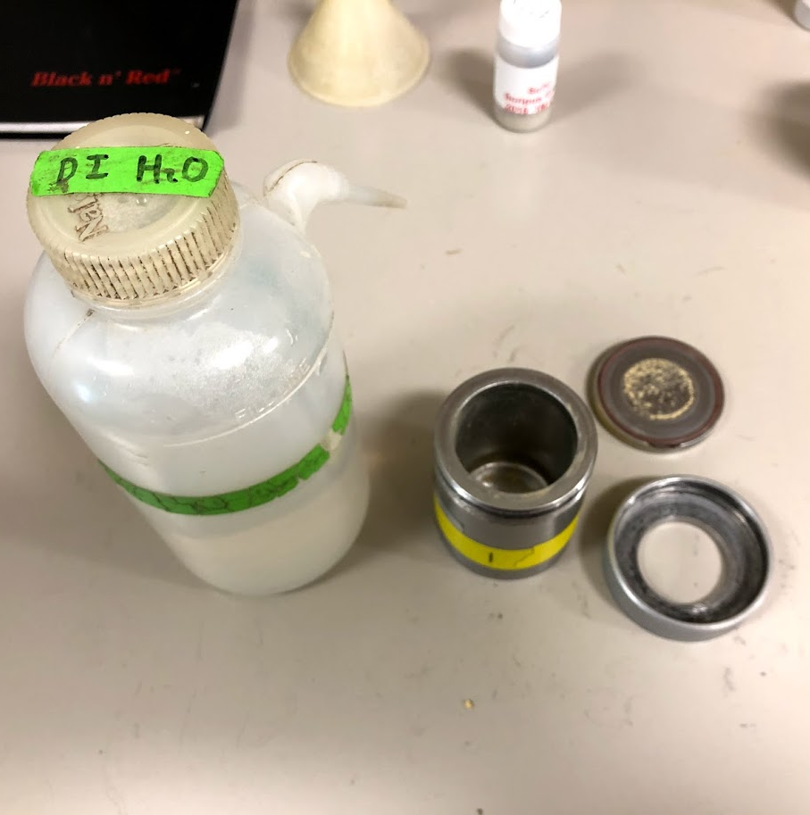
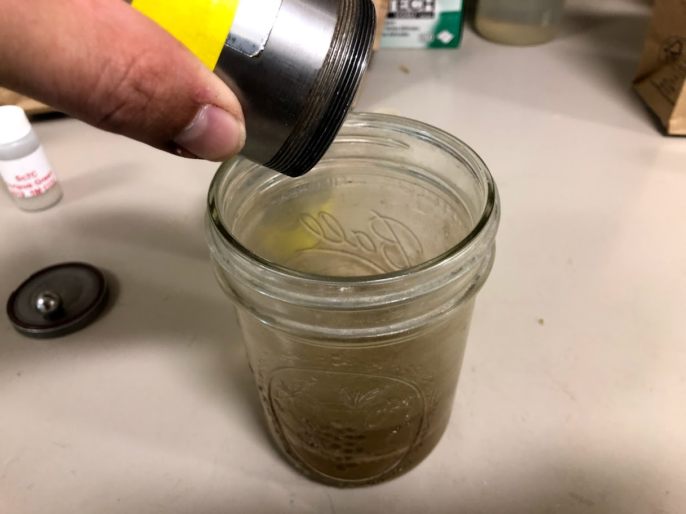
Thoroughly clean capsule with DI water
Squirt DI water into capsule
Remove ball with tweezers and pour liquid into discard container.
Place ball into and top on capsule. Shake up and down to wash thoroughly.

Slide 17
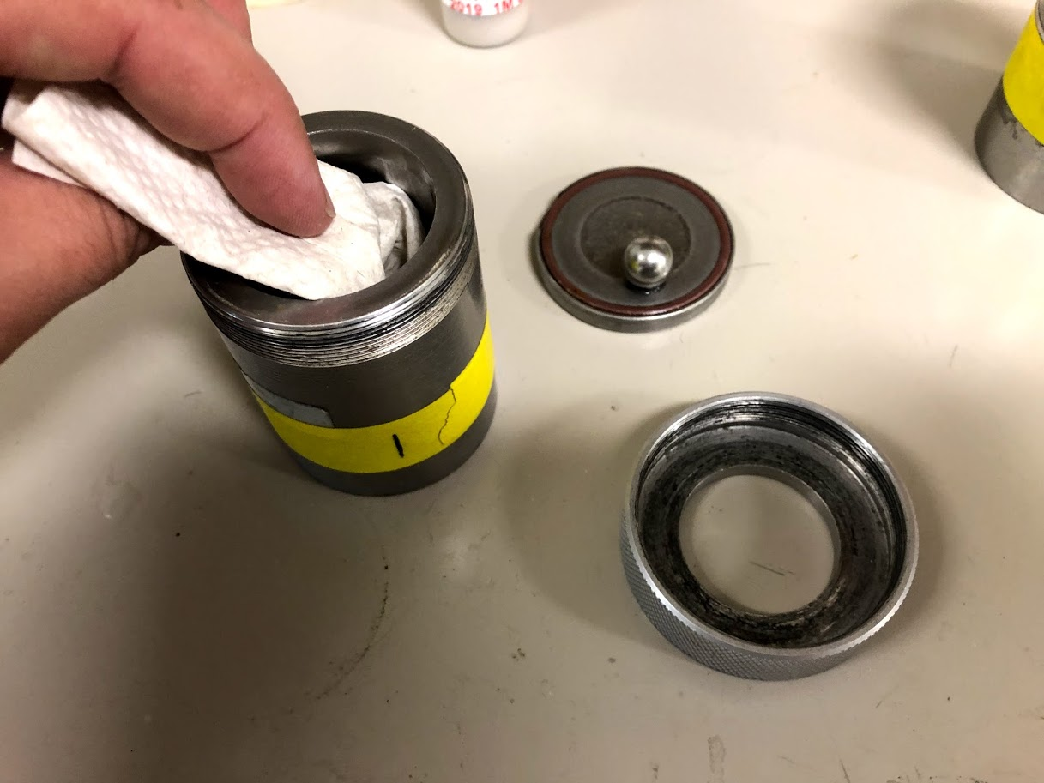
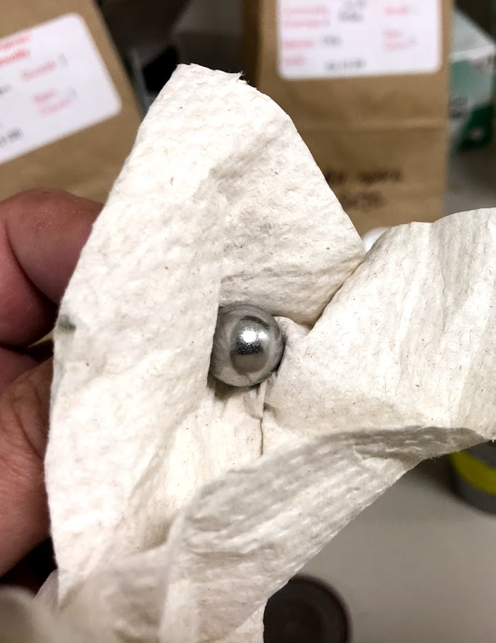
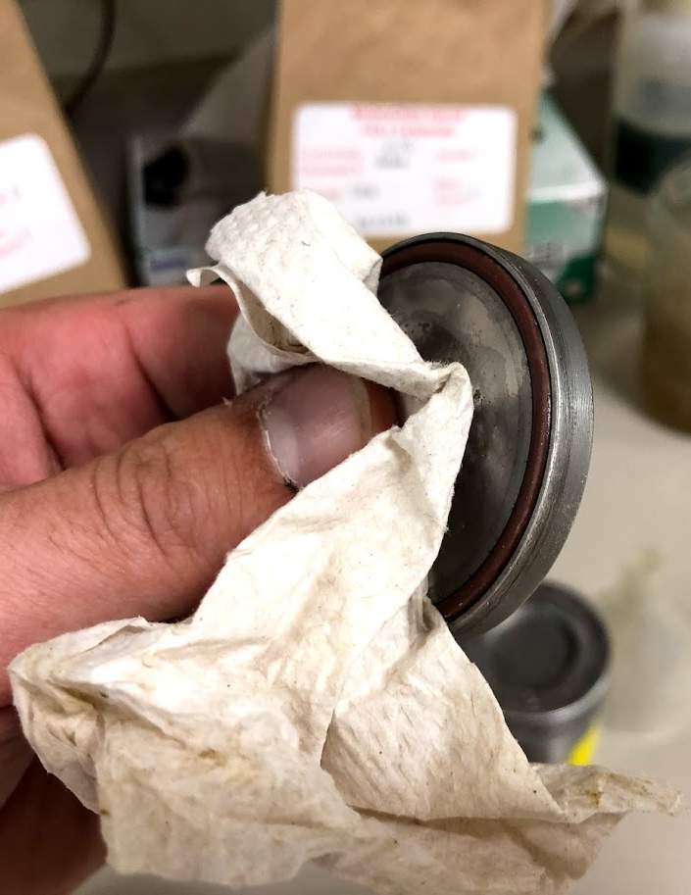
Thoroughly clean capsule with DI water
Use ½ piece of paper towel to clean/dry capsule completely.
Wipe clean/dry the metal ball and top to the capsule.
If any moisture is left over in the capsule, the next sample will become a thick paste and will be useless!

Slide 18
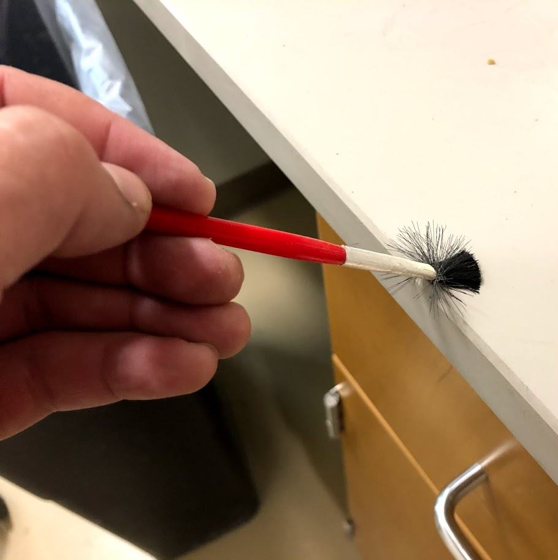
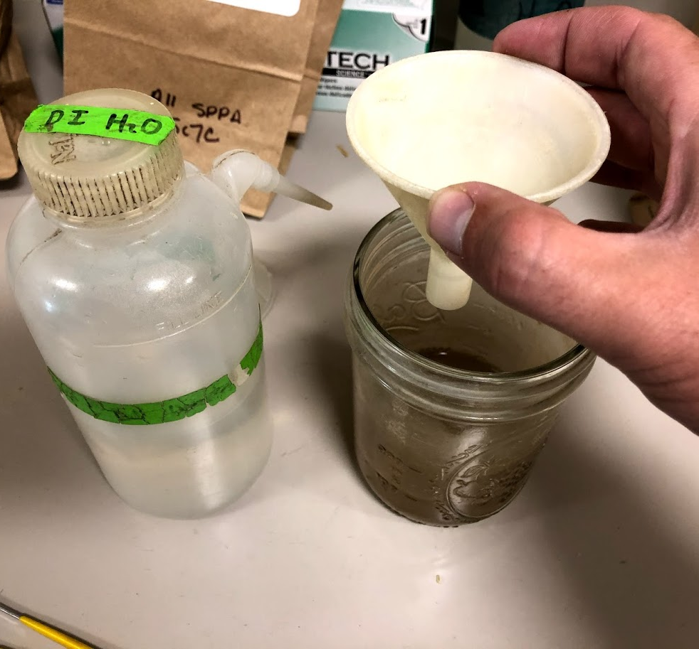
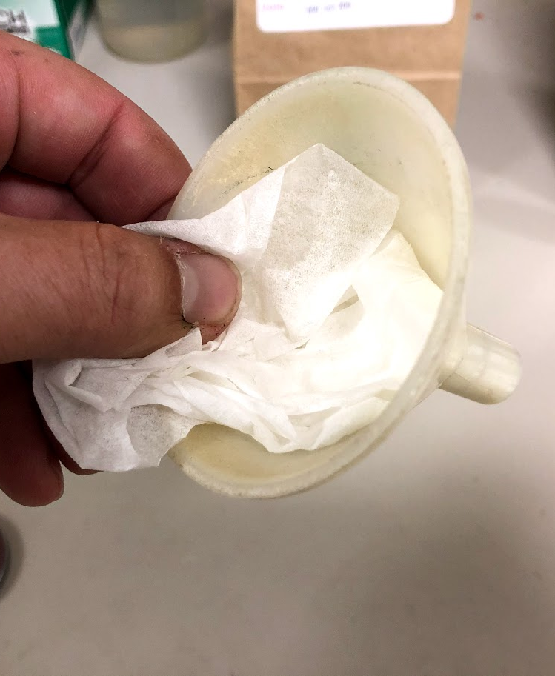
Clean brush and funnel
Clean brush by brushing it against the corner of the table repeatedly.
Clean funnel by rinsing the inside with DI water into discard container.
Wipe funnel clean/dry with a Kimwipe.

